Slide 1
Welcome to CS5002 Discrete Mathematics
I’m Dr. Molly Domino (she/her)
PhD in CS With a focus on Digital Ed.
BA in CS and English Literature
Before introductions though…

Slide 2

Lets talk about Math
Use the QR code above OR Go to menti.com Enter code: 3764 6859

Slide 3

Introduce yourself
Go around and share the following:
Name (and nickname?)
Pronouns
One piece of media you’ve enjoyed lately
Show
Movie
Book
Song/Album
Game
Shortform Digital Video
I swear I’m listening – I’m just also franticly writing everything down

Slide 4
My relationship with Math/CS
In Highschool
B student in the easier math classes
Very much had an identity of “not being a math person”
In College
Took CS 101 to complete a math credit for my degree
It didn’t have MATH in the prefix
Decided to stop when I stopped enjoying the subject
Maybe a minor?
I now have a doctorate…?

Slide 5
My relationship with Math/CS And why it matters for the ALIGN
I mean
If I can do it YOU can
Math in high school is often Calculus Prep
There is a lot of math OUTSIDE of that world
Nobody told me that
Don’t identify with what you’re bad at
Everyone can learn a new (hard?) thing
Maybe you’ll even discover it’s not so bad

Slide 6
Policies
Mostly in the syllabus
Which you’re reading for your homework
Most importantly
I want to help you learn and succeed
Let me know how I can help and I will
All policies can be changed
I will if I see folks gaming the system

Slide 7
Attendance
In person or over zoom
F1 visa holders primarily in person
Prioritize your safety (Ex. Illness, Maine Weather)
Coming to class is necessary most of the time
There’s a quiz* at the start of class most days
I’d like an email from you if you can’t make it
At least 24 hours prior
Some flexibility for emergencies
Lectures are always recorded and available on request
Come ready to participate
If you can’t, I’d rather you take time for yourself
You’ll be able to make up the quiz
*don’t panic – more on this in a bit

Slide 8
Quiz / Exam policy
Gotta be here to take it
As low stress as I can make them
Come and give a good effort in class
When you get your grade, you can write up a report on the wrong answers
Recoup 75% of lost points
So a 63 can still become a 90
This policy could be revised mid-semester depending on how it works out

Slide 9
Homework Policy
Due 11:59 EST night before class
Currently no regrading available
This could change depending on TA bandwidth
I teach Tuesday night so last minute questions will not be answered in time!

Slide 10

Late Policy
Life gets in the way but communication is important
Email me 24 hours in advance (minimum) if you need more time
Allowances for emergencies
Include a proposed date of when you can complete the work
I’d rather you take another day and learn over cheating

Slide 11
Plagiarism polices
I can’t make a perfect “no cheating” policy
As much as I’d like to
Quiz retaking and late policies are flexible
Try and test your knowledge first
Then learn from mistakes

Slide 12
Lastly
This is my first semester running this course
Your patience is appreciated
As is your input!
At least for the next few weeks, homework will be posted EOD Wednesday
I need to figure out how much we get through before I give you work.
Apologies for the inconvenience.

Slide 13
Lets get into it
Discrete Math!

Slide 14
…what is it?
What does “discrete” mean?
Individual, separate and distinct
So: Individual, Separate and Distinct Math
..What does THAT mean?
Note – Discreet means to be careful or tactful (different word!)

Slide 15
Discrete Math
A form of mathematics concerned with discrete structures
Continuous Structures- some forms of Calculus and Euclidian geometry
Focus on “smooth change” (like a flowing curve)
Discrete Structures – Non-continuous
distinct, countable, change (like a set of points)

Slide 16
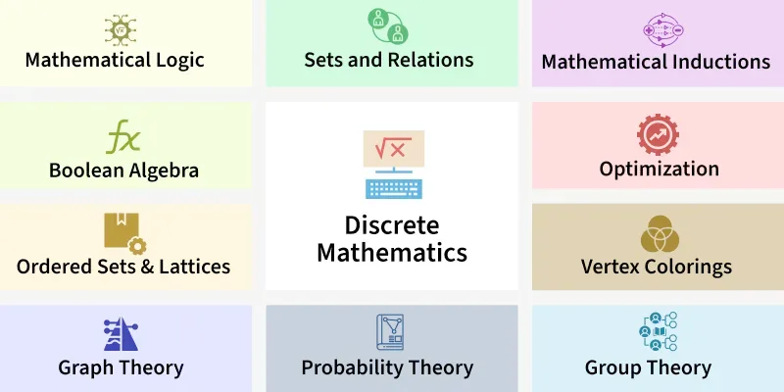
A bit of a double meaning
Discrete math classes are wildly different from one another There’s a lot here and everyone prioritizes different things

Slide 17
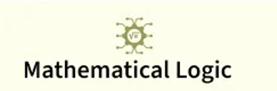
Today
Lets get in to our first subject
Actually – check in. Do we need a break first?

Slide 18
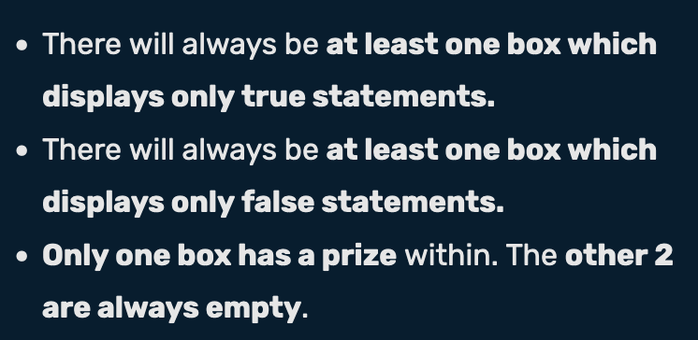
An example….
The statement on the white box is true
This box and the white box are empty
There are 4 boxes
The prize is here

Slide 19

Getting the answer is good But how do you KNOW it’s right
Lets consider all possible outcomes

Slide 20
Blue | White | Black | Outcome
True
True
True
Impossible
True
True
False
Impossible
True
False
True
Impossible
True
False
False
Impossible
False
True
True
Impossible
False
True
False
Impossible
False
False
True
Black and white are empty
False
False
False
Impossible
1. Per our rules – All 3 can’t be either True or False
2. White is obviously false (there are 3 boxes) so we can rule out any combo that involves White being True
3. If Blue were True, then white would NEED to be True – which it isn’t So blue can’t be True

Slide 21
One more (harder) Work in groups to solve
The black box is false
The black box is true
A false box contains the prize
The prize is here
Draw out the same kind of table and prove why you’re right
Or maybe it’ll help you figure it out
Note: you can get into groups on your own Or I can put you in a group

Slide 22
Lets consider all possible outcomes
Blue | White | Black | Outcome
True
True
True
Impossible
True
True
False
Impossible
True
False
True
Impossible
True
False
False
Impossible
False
True
True
False
True
False
Impossible
False
False
True
Black and white are empty
False
False
False
Impossible
1. Per our rules – All 3 can’t be either True or False
2. Blue and white can’t both be true
3. What if white and black are true…?

Slide 23
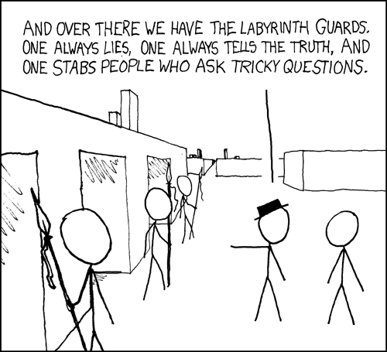
This is formal logic!
Lets add a bit more to our vocabulary…

Slide 24
Formal Logic
Logic Study of reasoning
Premise:
Critics like Ruth Reichl know a great deal about food, cooking techniques, and restaurant operations
Conclusion:
Food critics are highly trustworthy
Scope of logic (for today)
Evaluating the truth content of a series of statements
Using a set of formalized rules to deduce truth
“Critics like Ruth Reichl, former editor-in-chief of Gourmet magazine, have built careers on their deep knowledge of food, cooking techniques, and restaurant operations. Therefore food critics are highly trustworthy”

Slide 25
Deductive Inference
P1 – Venus is closer to the Sun than the Earth
P2 – Earth is closer to the Sun than Mars
C – Venus is closer to the sun than Mars
Deductive inference – inference where C is guaranteed to be true (provided the premise is also true)
As opposed to an inductive inference
High probably of truth rather than guaranteed
Ok – we’re going to transition from talking about inferences for a bit and focus on evaluating statements

Slide 26
Propositional logic
Originated with Aristotle
George Boole’s rules for combining propositions

Slide 27
Propositional logic
Propositions - declarative sentence that is either true or false
No grey area allowed
Ex
1 + 1= 2 → True
Maine is north of all of Canada → False
Non-examples
What time is it?
X + 12 = 2
Can be true or false depending on what X is

Slide 28
We can perform operations on propositions like we can do math with numbers
Starting with the big 3
NOT
AND
OR

Slide 29
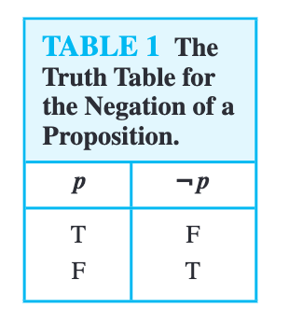
NOT
p = “Dr. Domino’s computer is a mac”
¬p = “Dr. Domino’s computer is NOT a mac”
¬ is a negation symbol
In this case
p is True
¬p is False
But…what if p represented a different statement?
p = “Today’s date is 12/12/2023” (False)
¬p = “Today’s date is not 12/12/2023” (True)

Slide 30
Note - negation is not correction
p = “Today’s date is 12/12/2023”
¬p could not be phrased as “It is currently 2026”
or even “Today’s date is <thedate>”
It simply said “not whatever p said”

Slide 31
Combining 2 propositions: Conjunction
p ∧ q is translated as “p and q”
I mix this up constantly (apologies)
p = “I will make dinner when I am hungry”
q = “I will make dinner when I have groceries”
p ∧ q = “I will make dinner when I am hungry and when I have groceries”
True only if both P and Q are true

Slide 32
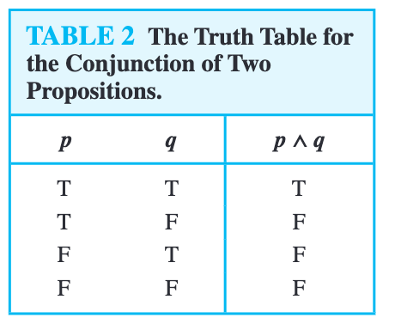
Truth table for Conjunction
Hungry and have groceries. = Dinner!
Hungry but no groceries. = no dinner
Groceries but not hungry = no dinner
No Groceries and not hungry = no dinner

Slide 33
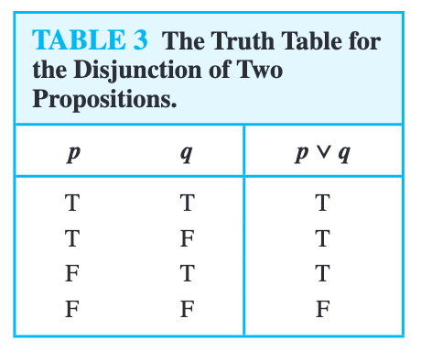
Combining 2 propositions: Disjunction
p ∨ q = “p or q”
Or both
p = “Andrea is the murderer”
q = “Charles is the murderer”
If Andrea did it and Charels is innocent, p ∨ q is true
If Andrea is innocent and Charles did it, p ∨ q is true
If they both did the murder p ∨ q is true
If neither did the murder….P V Q is false.

Slide 34



You now know the central pillar of computing: Circuits
Even complex algorithms can be broken down into a combination of ands, ors, and nots.
NOT GATE
AND GATE
OR GATE
If wire A has low voltage, output high voltage If wire A has high voltage – output low voltage
If wires A and B have high voltage, output high voltage Otherwise low voltage
If either A or B (or both) have high voltage, output high voltage Otherwise low voltage

Slide 35
Making this more complex
P V Q is a pretty easy statement to figure out
And 4 possibilities are all pretty easy to keep in your head

Slide 36
So – how about a bigger combination
((P V Q) ∧ (¬(P∧ Q))
¬ - not
∧ - and
V - or
I like to break it down into smaller pieces to help keep myself organized Your milage may vary -
P | Q | A = P V Q | B = ¬(P∧ Q) | A ∧ B
T | T
T | F
F | T
F | F
Fill in the truth table

Slide 37
For the following 3 practice questions…
Keep track of your answers
I’ll go get pen and paper if necessary
There are also whiteboards to start with
I’ll have you submit them at the end of class
Feel free to work with a group
Just write everyone’s name down
Everyone must submit individually

Slide 38
Practice 1:
There are at least 2 answers to this question Maybe more?
Use AND, OR, and NOT to create a statement that is only true when both P and Q are false.
F | Q | ???
T | T | F
T | F | F
F | T | F
F | F | T
¬P ∧ ¬Q
¬(P V Q)
F ∧ F = F
¬ (T V T )= F
F ∧ T = F
¬ (T V F )= F
T ∧ F = F
¬ (F V T )= F
T ∧ T = T
¬ (F V F )= T

Slide 39
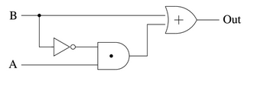
Practice 2
Use AND, OR, and NOT to translate this circuit diagram into a Boolean expression
A | B | ???
T | T
T | F
F | T
F | F
OR
NOT
AND
You may want more columns in your truth table

Slide 40
Practice 3: Write out the truth table for ¬P V (P∧Q) V (P∧¬Q)
P | Q | A = ¬P | B = (P∧Q) | C = (P∧¬Q) | A ∨ B ∨ C
T | T
T | F
F | T
F | F
I like to break it down into smaller pieces to help keep myself organized Your milage may vary -

Slide 41
Notably:
¬P V (P ∧ Q) V (P∧¬Q) is always True, regardless of what P and Q are
We call this a “tautology”
P | Q | A = ¬P | B = (P ∧ Q) | C = (P∧¬Q) | A ∨ B ∨ C
T | T | F | T | F | F V T V F → T
T | F | F | F | T | F V F V T → T
F | T | T | F | F | T V F V F → T
F | F | T | F | F | T V F V F → T
A statement that is always false regardless of input is a contradiction (Ex. P ∧ ¬P)

Slide 42
Pause
Molly – publish In Class Work - Week 1
Students – Complete In Class Work - Week 1 on canvas and submit the pdf
Then let’s evaluate how much time is left in class

Slide 43
Logical equivalence

Slide 44
Determining if two statements are true / false under the same conditions
P V Q is logically equivalent to Q V P.
Shorthanded to P V Q ≡ Q V P
Equals sign with an extra line
This is going to give us the building blocks to start performing some transformations
More on that in a minute

Slide 45
Proving Logical equivalence
If two columns of a truth table are identical – the two statements are logically equivalent
p | ¬p | ¬(¬p)
T | F | T
F | F | F
This is actually a law we can rely on!
Double Negative Law
If you ever see ¬¬P , you can safely just transform that to P and your logical statement will not change
P and ¬¬P end up looking identical
Therefore they are logically equivalent. We shorthand this as P ≡ ¬¬P

Slide 46
Practice
A = P ∧ (Q V R)
B = (P V Q) ∧ (P V R)
Is A logically equivalent to B?
Prove with a truth table
P | Q | R | P ∧ (Q V R) | (P V A) ∧ (P V R)
T | T | T
T | T | F
T | F | T
T | F | F
F | T | T
F | T | F
F | F | T
F | F | F
No need to keep track of or submit this problem!

Slide 47


Going through it…
P | Q | R | Q V R | P ∧ (Q V R) | (P V Q) ∧ (P V R)
T | T | T
T | T | F
T | F | T
T | F | F
F | T | T
F | T | F
F | F | T
F | F | F
Again – I prefer to break these down into smaller pieces If you can hold everything in your head without getting anything mixed up go for it

Slide 48
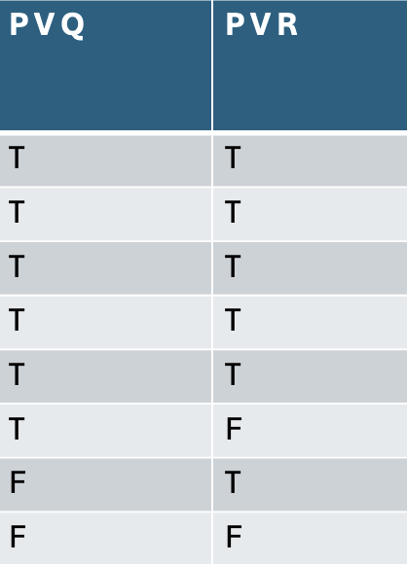
Going through it…
P | Q | R | P V Q | P V R | (P V Q) ∧ (P V R)
T | T | T |  |  | T
T | T | F |  |  | T
T | F | T |  |  | T
T | F | F |  |  | T
F | T | T |  |  | T
F | T | F |  |  | F
F | F | T |  |  | F
F | F | F |  |  | F

Slide 49
Practice
A = p ∧ (q V r)
B = (p V q) ∧ (p V r)
Is A logically equivalent to B?
Prove with a truth table
P | Q | R | P ∧ (Q V R) | (P V Q) ∧ (P V R)
T | T | T
T | T | F
T | F | T
T | F | F
F | T | T
F | T | F
F | F | T
F | F | F
No need to keep track of or submit this problem!
Then yes these are logically equivalent statements!

Slide 50
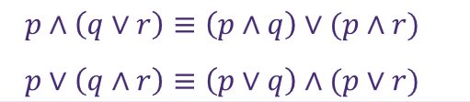
P ∧ (Q V R) ≡ (P V Q) ∧ (P V R)
This is another law we can rely on!
The Distributive laws:
You can enter the building if you have an ID and a keycard or code P = Have ID
Q = Have keycard R = Have code ID and (keycard or code)
is the same as
(ID and keycard) or (ID and code)

Slide 51
Practice 4 ¬(P∨Q)≡(¬P∧¬Q) Using a truth table
Remember
V represents logical OR
∧ represents logical AND
Both are used in the above statement
No need to keep track of or submit this problem!

Slide 52
De Morgan’s law (another logical equivalence)
¬(p V q ) ≡ ¬p ∧ ¬ q
Not (p or q) is the same as not p and not q
¬(p ∧ q ) ≡ ¬p V ¬ q
Not (p or q) is the same as not p and not q
P | Q | ¬ (P V Q) | ¬P ∧ ¬ Q
T | T | F | F
T | F | F | F
F | T | F | F
F | F | T | T

Slide 53
Negation, Identity, and Domination
Negation laws
p ∨ ¬p ≡ T
P or not P is always true (a tautology)
p ∧ ¬p ≡ F
P and not p is always false (a contradiction)
Identity – it all depends on P
p ∧ True ≡ p
p V False ≡ p
Annihilator laws – P is irrelevant
p ∨ True ≡ True
p ∧ False ≡ False

Slide 54
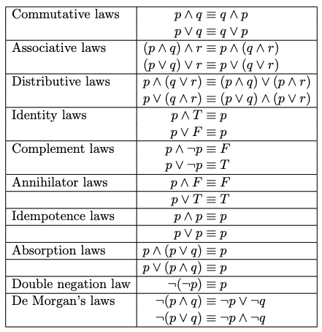
There are many laws we can talk about…
Don’t memorize this – just keep this table as a reference And be ready to add to it later

Slide 55
Another way to prove logical equivalence: Equivalence Proofs
Rather than truth tables we could prove
statement A ≡ statement B
By transforming statement A into statement B using these rules

Slide 56
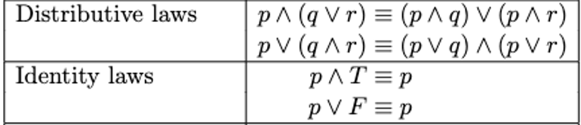
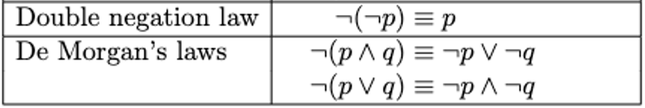
Ex. Let’s Prove… ¬(p ∨ (¬p ∧ q )) ≡ ¬p ∨ ¬q
We’ll only need these laws to solve this one
If we started with…. | And used _____ to transform | We’d get….
¬(p ∨ (¬p ∧ q ))
De Morgan’s law
¬p ∧ ¬(¬p ∧ q )
¬p ∧ ¬(¬p ∧ q )
De Morgan’s law (again)
¬p ∧ (¬¬p V ¬q )
¬p ∧ (¬¬p V ¬q )
Double Negative
¬p ∧ (p V ¬q )
¬p ∧ (p V ¬q )
Distributive law
(¬p ∧ p) V (¬ p ∧ ¬q )
(¬p ∧ p) is always going to be false so we can replace that with FALSE
FALSE V (¬ p ∧ ¬q )
Identity Law
(¬ p ∧ ¬q )
Therefore: ¬(p ∨ (¬p ∧ q )) ≡ ¬p ∨ ¬q

Slide 57
Some quick unrelated transformations: Fill in the blank
If we started with…. | And used _____ rule to transform | We’d get….
¬(T ∧ R) |  | ¬T V ¬R
R V (S V T) |  | (R V S) V T
¬ A V ¬ B |  | ¬ (A ∧ B)
(S V P ) ∧ (S V Q) | Distributive Law
 | Double Negative Law | ¬(¬R)
(A ∧ B) V TRUE |  | TRUE
De Morgan’s Law
Associative Law
De Morgan’s Law
S V (P ∧ Q)
R
Annihilator Law

Slide 58
More practice: Use our logical equivalence laws to prove…
1. ¬¬A V (A ∧ B) ≡ A
2. ¬(R V ¬R ) ≡ False (contradiction)
3. (¬C ∧ ¬D) ∨ ((¬C ∨ C) ∧ D) ≡ D ∨ ¬C
There are possibly more than one way to solve these!
Optional Challenge if you finish before your peers… Are the following 2 statements logically equivalent? Prove it. Statement 1: ¬((X V Y ) ∧ (¬X V Z)) Statement 2: (¬Y ∧ ¬Z) V (¬X V ¬Y )

Slide 59

¬¬A V (A ∧ B) ≡ A
If we started with…. | And used _____ rule to transform | We’d get….
¬¬A V (A ∧ B) | Double Negation | A V (A ∧ B)
A V (A ∧ B) | Absorption | A

Slide 60


¬(R V ¬R ) ≡ False
If we started with…. | And used _____ rule to transform | We’d get….
¬(R V ¬R ) | De Morgan’s | ¬R ∧ ¬¬R
If we started with…. | And used _____ rule to transform | We’d get….
¬R ∧ ¬¬R | Double Negative | ¬R ∧ R
¬R ∧ R | Complement | False

Slide 61




(¬C ∧ ¬D) ∨ ((¬C ∨ C) ∧ D) ≡ D ∨ ¬C
If we started with…. | And used _____ rule to transform | We’d get….
(¬C ∧ ¬D) ∨ ((¬C ∨ C) ∧ D) | Complement | (¬C ∧ ¬D) ∨ (TRUE ∧ D)
If we started with…. | And used _____ rule to transform | We’d get….
(¬C ∧ ¬D) ∨ (TRUE ∧ D) | Identity | (¬C ∧ ¬D) ∨ D
If we started with…. | And used _____ rule to transform | We’d get….
(D V ¬C) ∧ (D V ¬D) | Complement | (D V ¬C) ∧ TRUE
(¬C ∧ ¬D) ∨ D | Distribution | (D V ¬C) ∧ (D V ¬D)
(D V ¬C) ∧ TRUE | Identity | (D V ¬C)

Slide 62
End of class (I assume)
We’ll come back to this next week – time to continue finishing up LaTeX practice on Overleaf

